Slide 1
A presentation on how Data Science model that explains how the factors impacted US Home prices over the last 20 years.
By - Yash Khandelwal

Slide 2

Key Factors influencing US residential house prices
Problem Statement
Demand
Supply
GDP
Marriage & Divorces
Income & Employment
Active Listings
Mortgage Interest Rate
New Homes
Property Prices
Mortgage Delinquency Rates
Population & Immigration
Marriage & Divorces
Permits

Slide 3
Data Collection
S No. | Dataset Usage | Data Source
1 | US House Price Index | https://fred.stlouisfed.org/series/CSUSHPISA
2 | Mortgage Average Interest | https://fred.stlouisfed.org/series/MORTGAGE30US
3 | Gross Domestic Product (GDP) | https://fred.stlouisfed.org/series/GDP
4 | Unemployment Rate | https://fred.stlouisfed.org/series/UNRATE
5 | Property Prices | https://fred.stlouisfed.org/series/QUSR628BIS
6 | Personal Income | https://fred.stlouisfed.org/series/PI
7 | Population | https://fred.stlouisfed.org/series/POPTOTUSA647NWDB
8 | Immigration | https://www.dhs.gov/immigration-statistics/yearbook/2019/table1
9 | Marriage and Divorce | https://www.census.gov/data/tables/time-series/demo/families/marital.html
10 | Active Listing | https://fred.stlouisfed.org/series/ACTLISCOUUS
11 | Permit | https://fred.stlouisfed.org/series/PERMIT
12 | New Homes | https://fred.stlouisfed.org/series/HOUST
13 | Mortgage Delinquency Rate | https://fred.stlouisfed.org/series/DRSFRMACBS

Slide 4
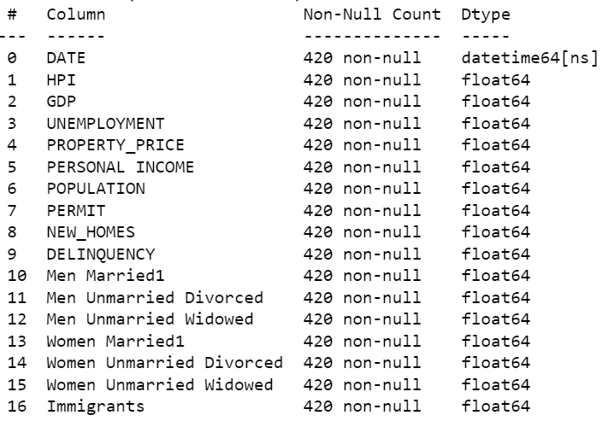

Data Collection
Joining Datasets -
Joined HPI with GDP, Employment, Property Prices, Personal Income, Population, House Listing, Permit, New Houses and Delinquency Rate data through left join on Date attribute.
Joined the resulting data with Marital data (Men Married, Men Divorced, Men Widowed, Women Married, Women Divorced, Women Widowed) and Immigration data through left join on Year attribute.
Resulting Dataset -
Link to data collection code: https://drive.google.com/file/d/1IR4hqMk-vyutkKZDdw6Q3GozISZlcBmA/view?usp=sharing

Slide 5
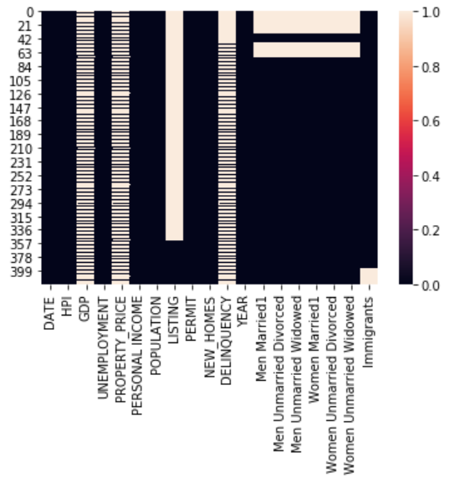
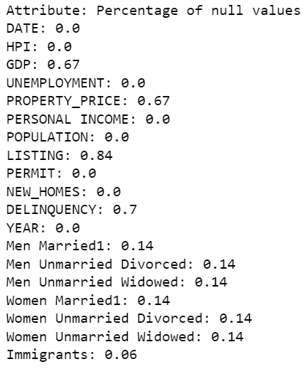
Data Pre-processing
Dealing with null values -
a) Distribution of null values
b) Percentage of null values
Defining the two approaches for the modelling - 1. Time series approach: Assuming that seasonality influences the HPI & that future trends will hold similar like historical trends. The null value imputation, feature engineering, data split & modelling has been done along time-series methods.
2. Machine Learning approach: Assuming that seasonality doesn’t influence the HPI. The null value imputation, feature engineering, data split & modelling using has been done using classical Machine Learning techniques.

Slide 6
Data Pre-processing
Dealing with null values –
Time Series approach (Multivariate Time series)
Machine Learning Approach
GDP - Nearest Neighbour interpolation followed by linear interpolation in both directions.
Property Prices, Mortgage Delinquency Rate - Same imputation strategy as used for GDP.
Men Married, Men Unmarried Divorced, Men Unmarried Widowed, Women Married, Women Unmarried Divorced & Women Unmarried Widowed (Marital Data) -
Backward Linear interpolation.
Immigration - Forward linear interpolation.
Listing - Dropped the feature due to high percentage of null values. Data only after 2016 available.
GDP - Imputed the available GDP of the nearest date.
Property Prices, Mortgage Delinquency Rate - Same imputation strategy as used for GDP.
Men Married, Men Unmarried Divorced, Men Unmarried Widowed, Women Married, Women Unmarried Divorced & Women Unmarried Widowed (Marital Data) –
Imputed random samples from the respective attribute.
Immigration - Same imputation strategy as used for marital data.
Listing - Dropped the feature due to high percentage of null values. Data only after 2016 available.
Link to data pre-processing code: https://drive.google.com/file/d/17mSK1hpGPPre5b_kNEqwEkdwFGzZNxlA/view?usp=sharing

Slide 7
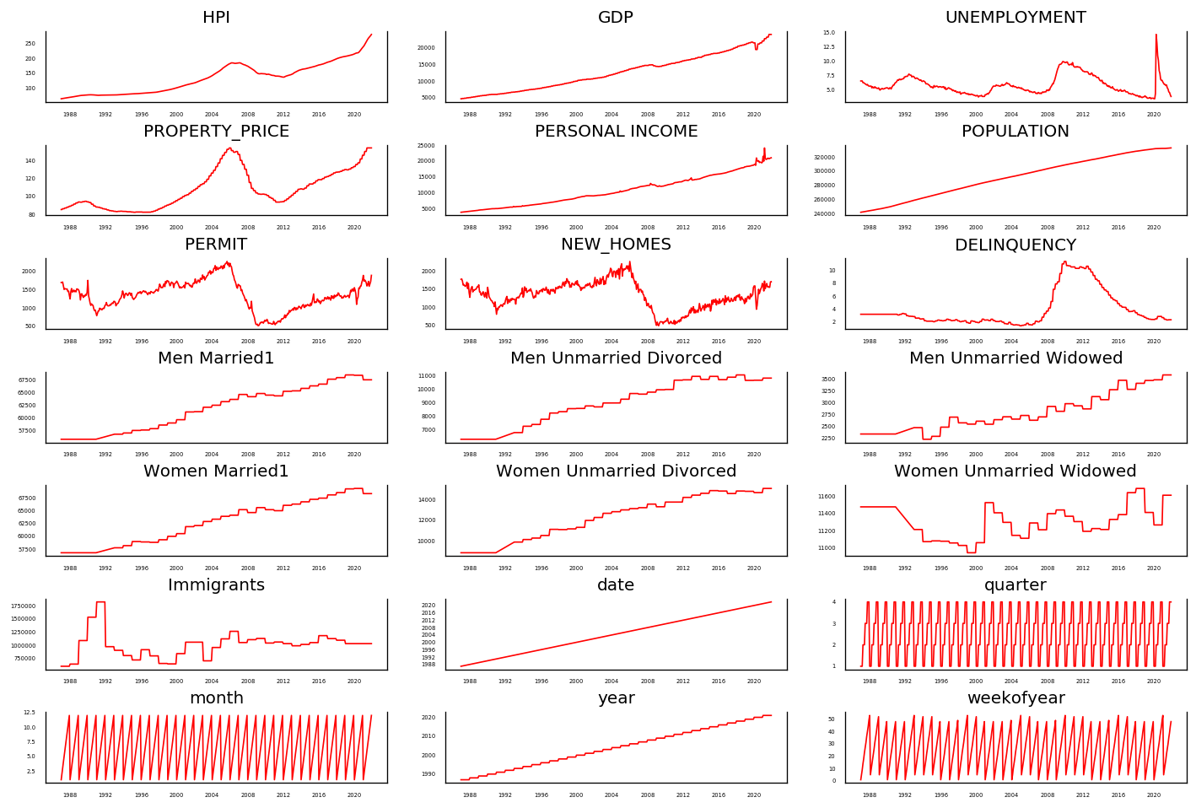
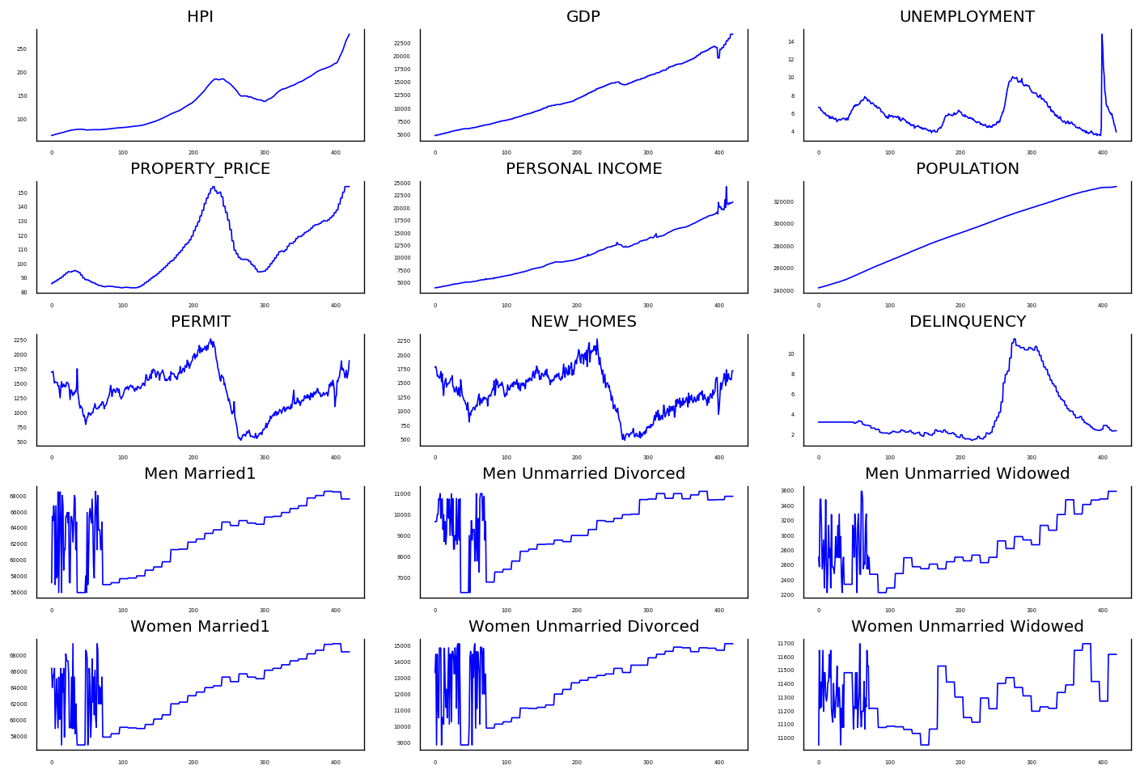
Feature Engineering
New time-series features extracted to capture datetime-based information (time-series approach) -
Week of the year, Quarter, Month & Year.
Univariate Analysis of the final data -
b) Non time-series approach
a) Time-series approach

Slide 8
Modelling and Evaluation
Time series approach
Machine Learning approach
Data split -
Training data: Data till 2014 (80%).
Testing data: Data after 2014 (20%).
Performance of XGBoost Regressor in multivariate time series forecast:
MAE: 29.699, RMSE: 41.52
Performance of other machine learning regression algorithms:
Linear Regression - MAE: 14.44, RMSE: 22.68
Lasso Regression - MAE: 12.04, RMSE: 17.98
Ridge Regression - MAE: 13.63, RMSE: 22.21
Decision Tree - MAE: 31.24, RMSE: 42.39
Random Forest - MAE: 32.73, RMSE: 43.60
Light Gradient Boost - MAE: 30.83, RMSE: 41.96
Data split -
Used K Fold Cross Validation (K = 5) applied after Standard Scaling
Performance of different machine learning regression algorithms (mean values of metrics) -
Linear Regression - MAE: 11.46, RMSE: 13.46
Lasso Regression - MAE: 5.35, RMSE: 6.84
Ridge Regression - MAE: 9.05, RMSE: 10.53
Decision Tree - MAE: 18.61, RMSE: 19.35
Random Forest - MAE: 17.55, RMSE: 21.33
Light Gradient Boost - MAE: 14.71, RMSE: 18.89
XGBoost – MAE: 14.46, RMSE: 18.57
Best model
Performance Explanation -
XGBoost has performed poorly in multivariate time series forecasting of HPI given date-time features and other features which indicates that HPI hasn’t been time dependent or hasn’t shown any seasonality. While the least error rates have been obtained in the non time series approach where Lasso regression has performed the best followed by Ridge Regression. Other machine learning algorithms have also given low errors compared to time series approach. Hence I’ll go Lasso regression with machine learning approach for predicting HPI and use it for obtaining the importance of features/factors in predicting HPI.
Link to data Modelling & evaluation code: https://drive.google.com/file/d/1WaJGn0UemKqkWrPybqD9JFpvt3uGWFyh/view?usp=sharing

Slide 9
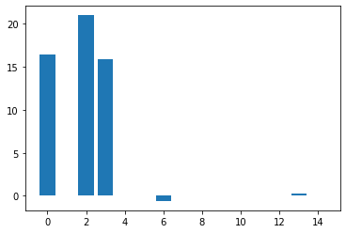
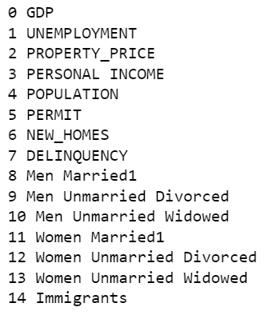
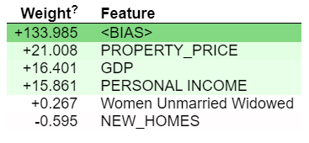
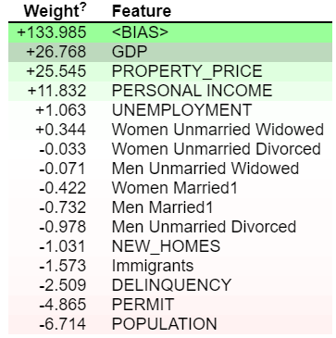
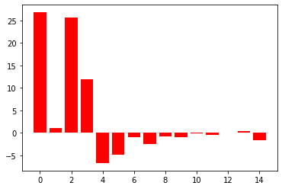
Feature Importance
Lasso Regression
Weight
Feature No.
A lot of coefficients of less influential features has been shrunk to 0 using the L1 regularization. To explain the relationship between all the features and HPI, lets use Ridge Regression (L2 regularization).
Ridge Regression

Slide 10
Interpretation
The topmost influencing factors for House Price Index are GDP, Residential Property/ Land price, Personal Income , Population, Permits granted.
Lets have a look at all the features and how they influence the US HPI using weights of features in trained Ridge Regression -
Factor | Type | How does the factor influence house price index?
Gross Domestic Product | Demand | GDP is the one of the indicators of economic growth of the country. GDP and HPI have a very strong positive dependence. The model predicts that a unit increase in GDP (billion $) would result to an approx. 27 units increase in House Price Index & vice versa.
Residential property/land Prices | Supply | Falling residential property prices can lead to restriction in the supply. Hence, it’s a crucial supply factor. The model predicts that a unit increase (% change) in Residential property price would result to an approx. 25 units increase in House Price Index & vice versa.
Personal Income | Demand | A high personal income in the country would mean that the population can afford expensive houses and there is a demand of luxurious living lifestyle. The model predicts that a unit increase (billion $) in total personal income would result to an approx. 12 unit increase in House Price Index & vice versa.
Population | Demand | An increasing population means an increase in the demand of houses. HPI is expected to increase with the population. However, the model predicts that a unit increase (million) in population would result to an approx. 7 units decrease in House Price Index & vice versa.
Permits | Supply | The model predicts that a unit increase (thousand) in permits would result to an approx. 5 units decrease in House Price Index & vice versa.

Slide 11
Interpretation
Factor | Type | How does the factor influence house price index?
Delinquency | Supply | A high delinquency rate would mean that the large number of houses may be added back to the supply due to foreclosure. The model predicts that a unit increase (million) in population would result to an approx. 2.5 units decrease in House Price Index & vice versa.
Immigrants | Demand | An increasing no. of immigrants means an increase in the demand of houses. HPI is expected to increase with rising immigrants. However, the model predicts that a unit increase in immigrants would result to an approx. 1.5 units decrease in House Price Index & vice versa.
Unemployment | Demand | The model predicts that a unit increase in unemployment rate would result to 1.06 units decrease in House Price Index & vice versa.
New homes | Supply | New homes (include units in structures being totally rebuilt on an existing foundation) reflects the supply of houses in the market. The model predicts that a unit increase (thousand) in new homes would result to an approx. 1.03 units decrease in House Price Index & vice versa.
Other factors such as marital data, divorces & death of partner | Supply & Demand | Marrying/expanding family, divorce & death means people shift to new houses leaving their existing house which in turn adds to demand and supply both. The model predicts that a unit increase in marriages would result to around 0.4 – 0.7 units decrease in House Price Index & vice versa & a unit increase in divorces would result to around 0.03 – 0.9 units decrease in House Price Index & vice versa.

Slide 12
Thank You!

